Slide 1
The DOK Trial
42 years of organic and conventional cropping systems
Andreas Fliessbach, Astrid Oberson, Klaus Jarosch, Jochen Mayer, Hans-Martin Krause, Paul Mäder

Slide 2
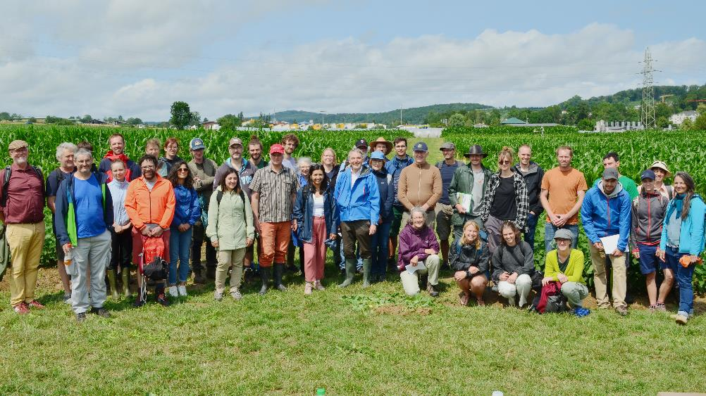
History and background
Since 1978
System comparison approach
Accompanied by farmers advisory board
Initial aim: test feasibility of organic agriculture
Today: research platform for farming system functioning

Slide 3
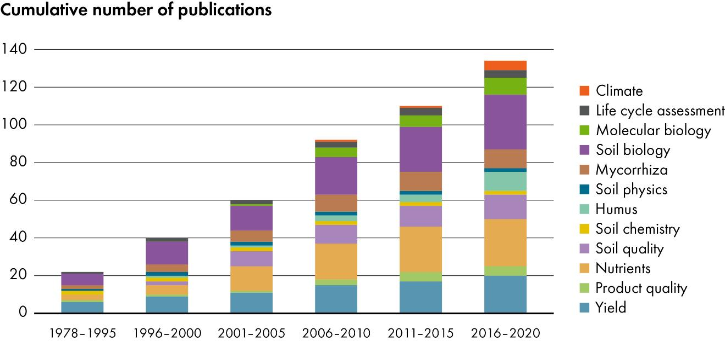
Publications

Slide 4
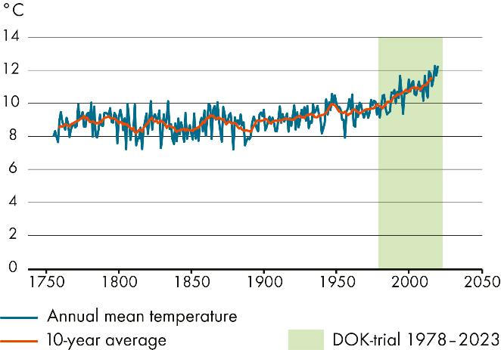
Location and climate
Located south of Basel between Therwil and Biel-Benken
Annual mean precipitation of 872 mm
Increasing temperatures during the course of the experiment
Annual mean temperature: (10-year average)
1978: 9.9 °C
2016: 11.5 °C

Slide 5
Field setup
Soil type: haplic luvisol
Soil type:
Sand 12 %
Silt 72 %
Clay 16 %
Same crop rotation and tillage in all systems
Mimicking certified farming systems

Slide 6
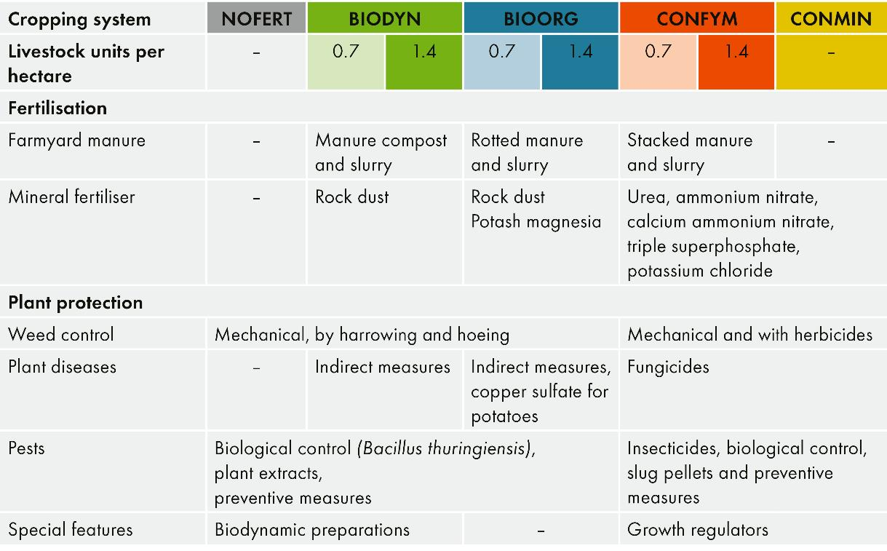
Cropping systems
BIODYN (D)
biodynamic (Demeter)
BIOORG (O)
organic (Bio Suisse)
CONFYM (K)
conventional (IP Suisse)
CONMIN (M)
conventional, purely mineral fertilised
Mäder et al. (2002): Science

Slide 7
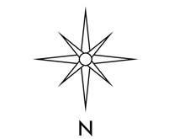
Plot plan
8 Treatments on 3 subplots (A, B, C)
Subdivided into 4 rows and 4 replicates
96 experimental plots (5x20m)
Fertilisation intensity
0.7 LU, 1.4 LU (1 = half, 2 = customary)
LU= Livestock unit

Slide 8
Crop rotation
Same crop rotation in all systems
Adapted after each crop rotation period (CRP)
7. CRP (2020-2026) similar to 6. CRP

Slide 9
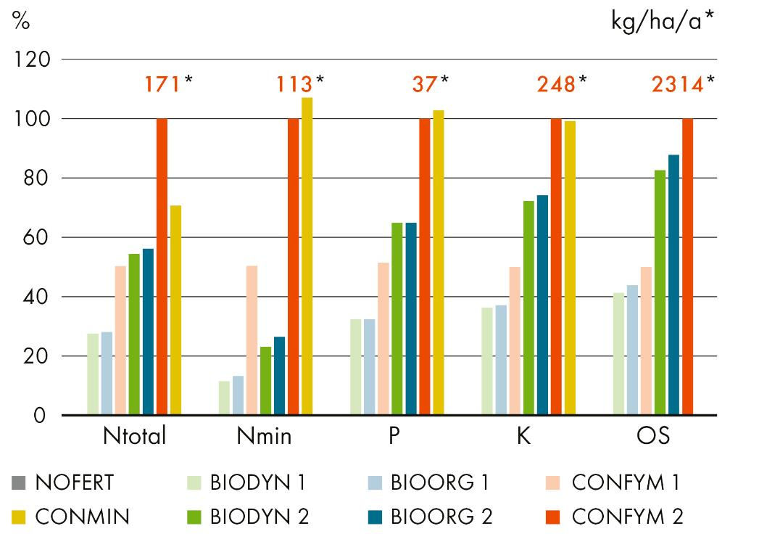
Fertilisation
Annual mean nutrient inputs (CRP 2-6)
Treatment-specific manures differ in composting duration and aeration
Organic systems at 0.7 LU receive half of nutrient inputs

Slide 10
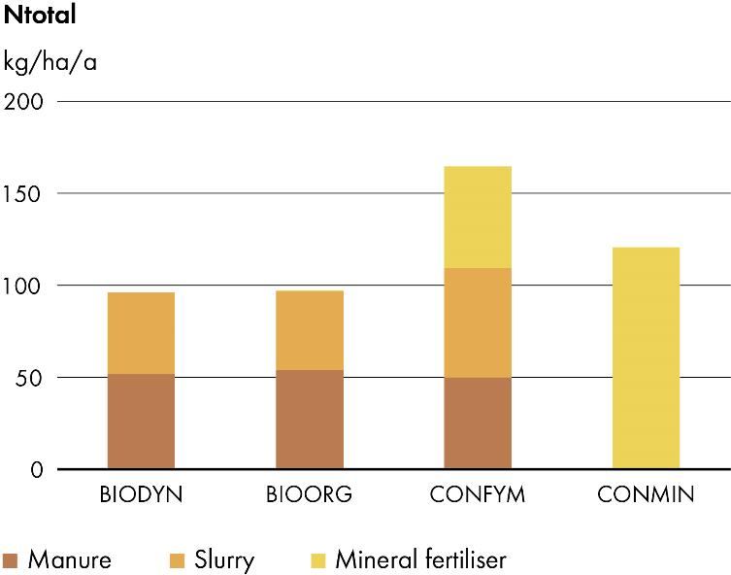
Nitrogen fertilisation
Sources and development of total nitrogen input in manure, slurry and mineral fertilisers

Slide 11
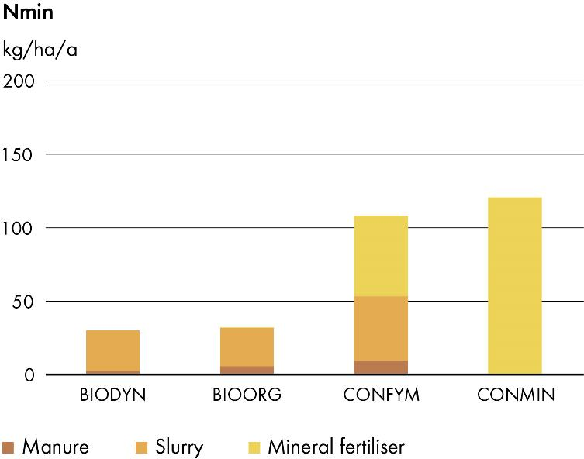
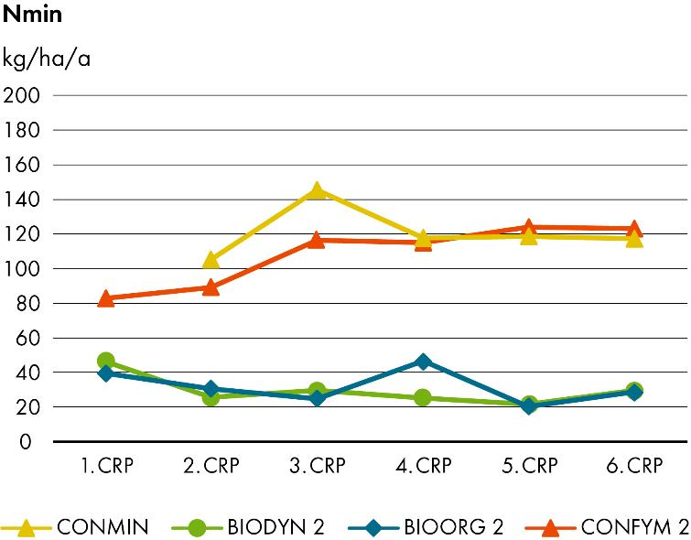
Nitrogen fertilisation
Sources and development of mineral nitrogen input in manure, slurry and mineral fertilisers

Slide 12
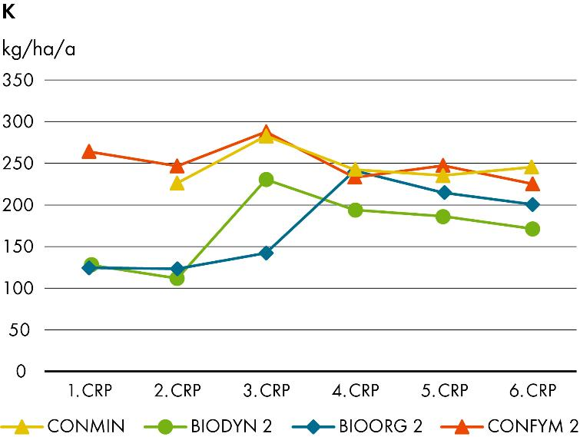
Phosphorous and potassium fertilisation
Evolution of phosphorous and potassium inputs

Slide 13
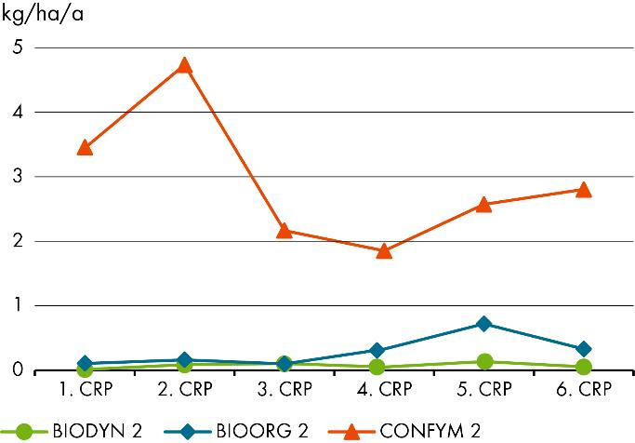
Plant protection
In kg active substance per hectare
Reduced pesticides inputs in CONFYM/CONMIN from 3rd CRP, but increasing numbers of applications
92 % less pesticides in BIODYN/BIOORG compared to CONFYM/CONMIN

Slide 14
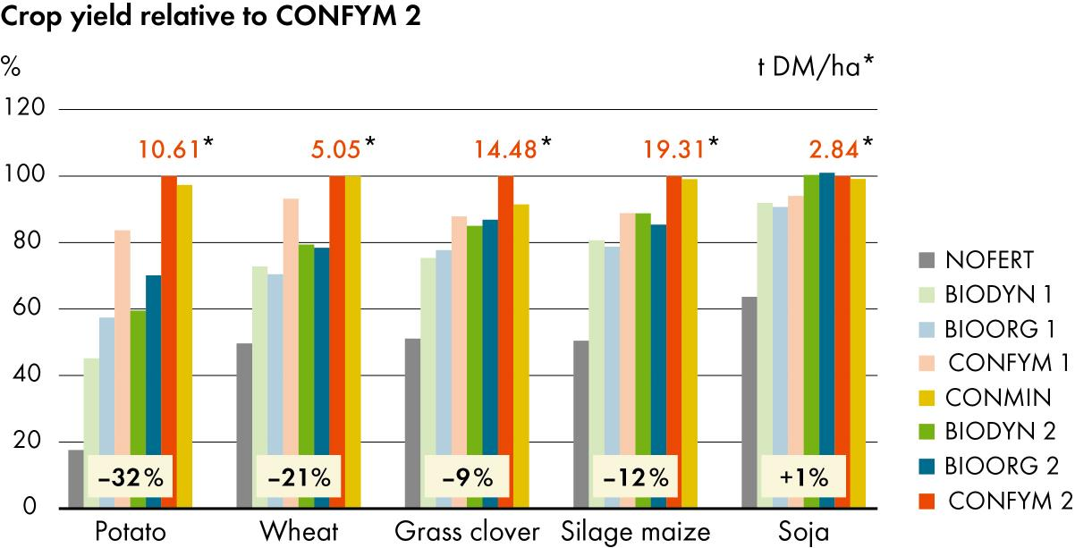
Yields
Yield gap decreases in dependency of crop: potato>wheat>silage maize> grass clover>soybean
15 % yield gap for organic systems at 1.4 LU across all crops (CRP 1-6)
Knapp et al. (2023): Field Crops Research

Slide 15
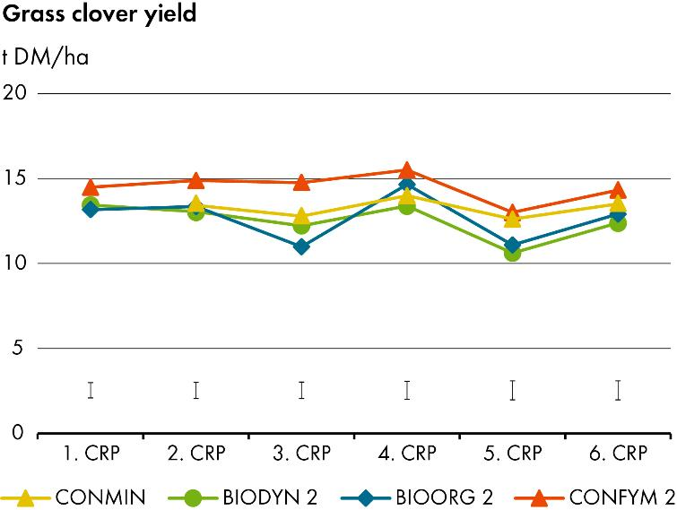
Yields
Mean wheat and grass clover yields per crop rotation period (CRP)

Slide 16
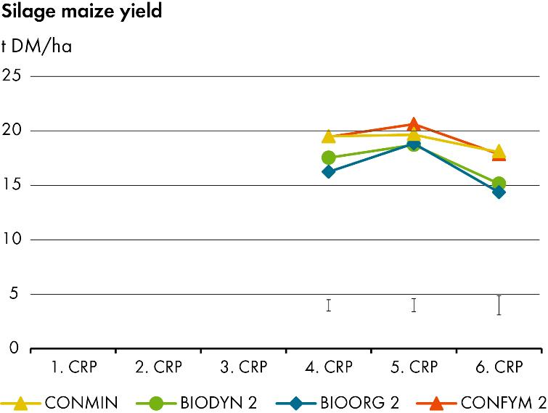
Yields
Mean potato and silage maize yields per crop rotation period (CRP)

Slide 17
Yields
Mean yields per crop rotation period (CRP)

Slide 18
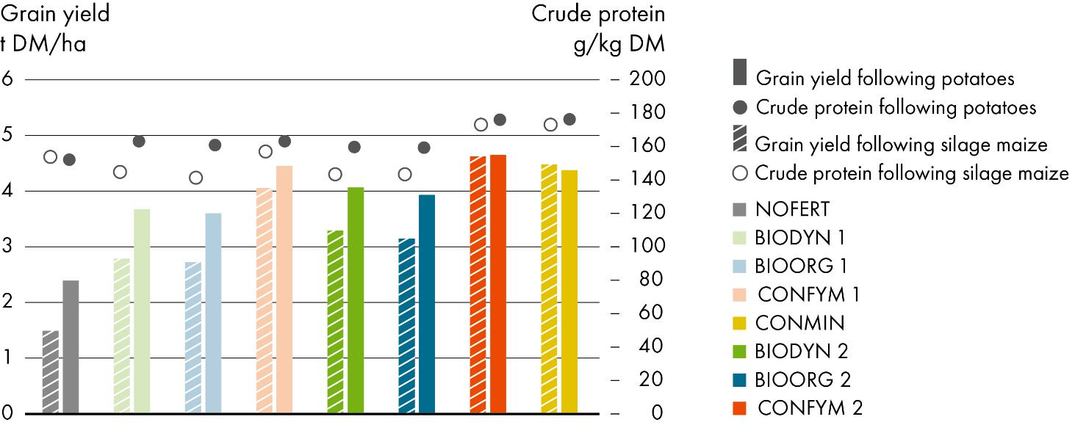
Winter wheat yields and crude protein content
Mayer et al. (2015): European Journal of Agronomy
Lower protein content in organic winter wheat especially after precrop maize

Slide 19
Nutrient balances
Removal via harvest, Input via fertilisation, symbiotic nitrogen fixation and deposition
Positive N balance in all organically fertilised systems at 1.4 LU
Negative P and K balance in almost all systems
Oberson et al. (2024): Agriculture, Ecosystems and Environment

Slide 20
Nutrient balances
Oberson et al. (2024): Agriculture, Ecosystems and Environment
High nitrogen use efficiency in all systems
Risk for P depletion in all systems

Slide 21
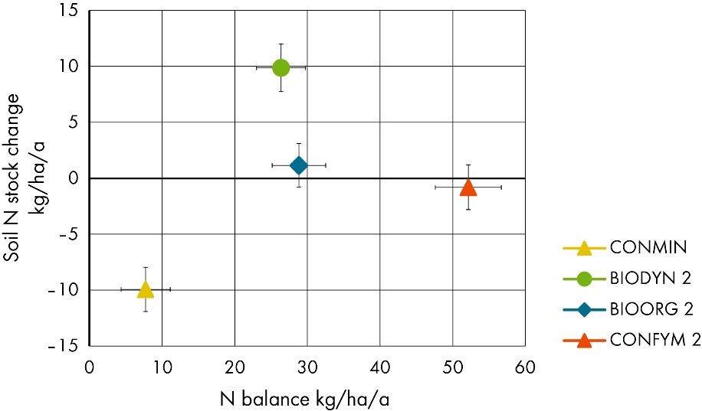
Soil nitrogen stocks and nitrogen balance
N balance across CRP 2-6 includes inputs via fertilisation, deposition, seeds and nitrogen fixation and outputs via harvest
CONFYM needs 50 kg ha⁻¹ yr⁻¹excess nitrogen to maintain soil N stocks
CONMIN looses soil N despite positive N balance, BIODYN gains soil N
Oberson et al. (2024): Agriculture, Ecosystems and Environment

Slide 22
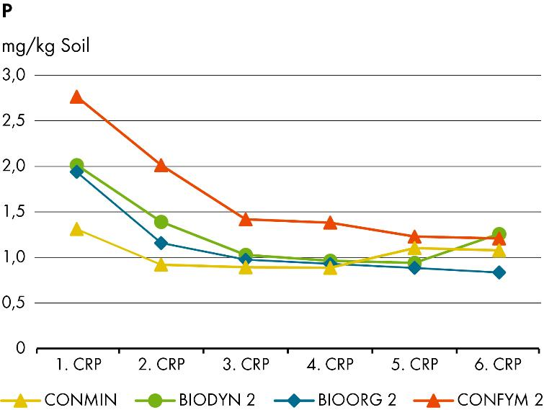
Soil phosphorus
Soil P stocks (n=4) and available soil P concentrations (n=32) across CRP1-6
CONMIN was left unfertilised in CRP1 and starts with low available P in CRP2
P depletion in all systems but slower decrease in CONFYM
Krause et al. (2024): Scientific Reports

Slide 23
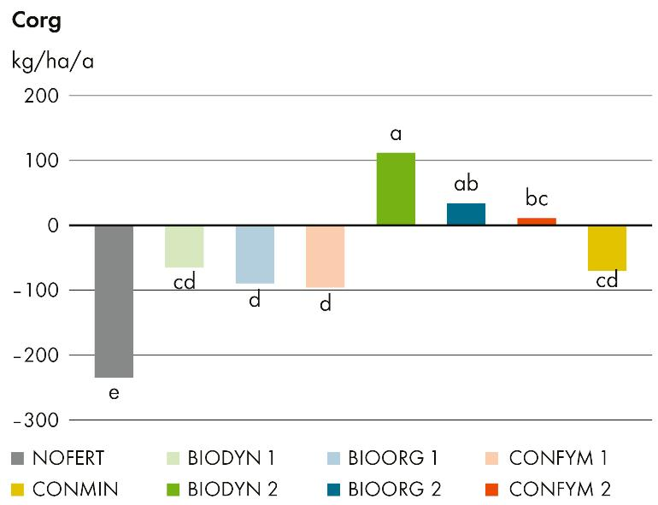
Soil organic carbon
All system at 0.7 LU, CONMIN and NOFERT loose SOC
Mixed farming with 1.4 LU can sustain SOC contents
Increased SOC contents in BIODYN presumably due to input quality
Krause et al. (2022): Agronomy for Sustainable Development

Slide 24
Soil organic carbon
Main differences in soil carbon stock occur in topsoil

Slide 25
Soil organic carbon inputs via Rhizodeposition
Hirte et al. (2017): Frontiers in Plant Science
Aboveground biomass does not correspond to belowground carbon inputs.
Higher roots and rhizodeposition input in BIOORG under maize only

Slide 26
Soil pH (H₂O)
Highest soil pH in BIODYN
Liming in CONFYM and CONMIN in CRP3

Slide 27
Soil borne greenhouse gas emissions
C-stock changes assuming constant bulk density for each parcel
N₂O measurement campaign for 571 days (grass clover - maize - cover crop)
Field site as system boundary
N₂O emissions drive climate impact
SOC increases, especially in BIODYN, did not enhance N₂O emissions
56 % lower soil borne GHG in BIODYN/BIOORG vs CONFYM/CONMIN
Skinner et al. (2019): Scientific Report
Krause et al. (2022): Agronomy for Sustainable Development

Slide 28
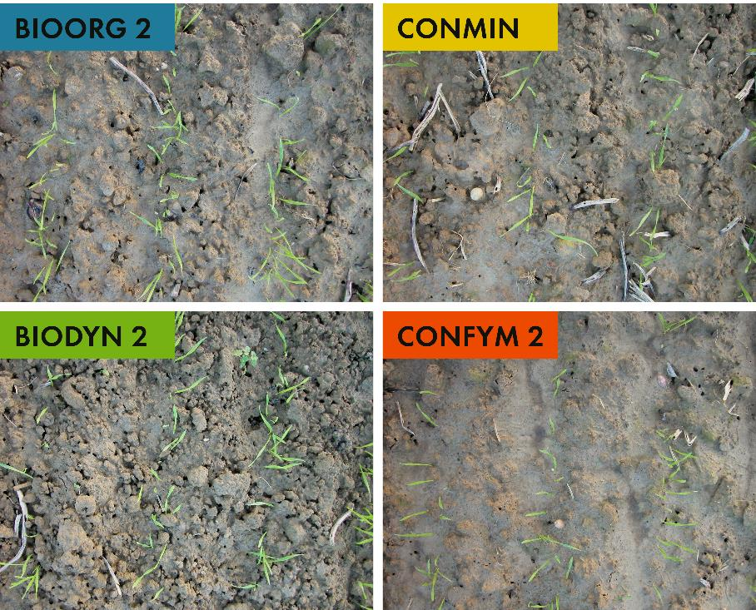
Soil structure

Slide 29
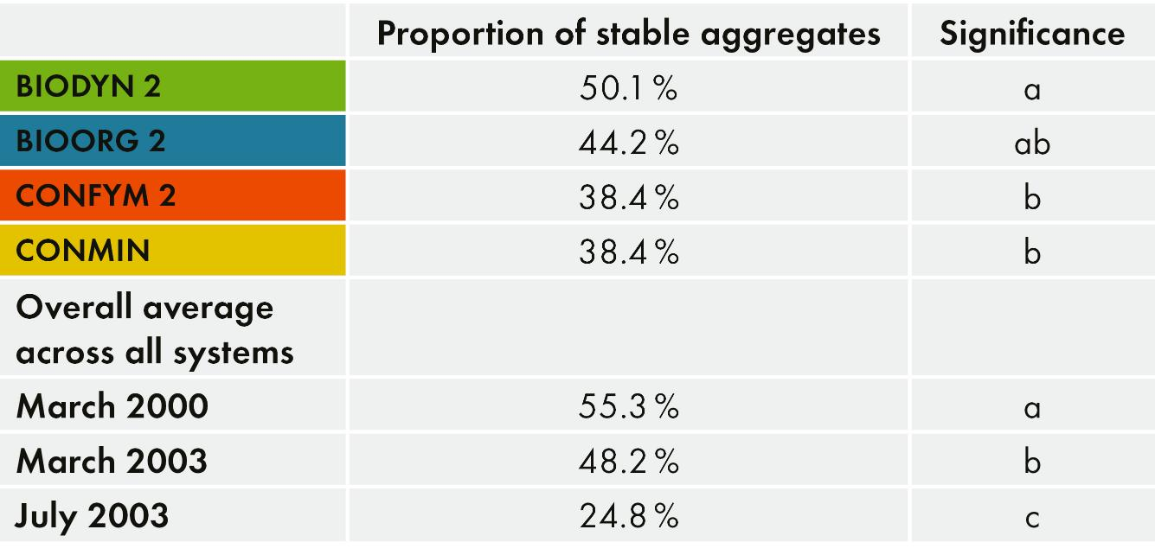
Soil aggregate stability
Fliessbach et al. (2000): Konferenzbeitrag

Slide 30
Biological soil quality
Highest biological soil quality in BIODYN, followed by BIOORG, CONFYM and CONMIN
Krause et al. (2022): Agronomy for Sustainable Development

Slide 31
Species diversity
BIOORG and BIOODYN showed increased diversity for microflora, macrofauna and weeds
Birkhofer et al. (2008): Soil Biology and Biochemistry
Hartmann et al. (2015): ISME Journal
Esperschütz et al. (2007): FEMS Microbiology Ecology
Pfiffner & Mäder (1997): Biological Agriculture & Horticulture
Rotchés-Ribalta et al. (2020): Applied Vegetation Science

Slide 32
Soil microbial diversity
Amplicon approach targeting 16S rRNA and ITS marker genes
Stronger influence of the cropping system on fungi
Stronger influence of organic fertiliser intensity on bacteria
Lori et al. (2023): FEMS Microbiology Ecology

Slide 33
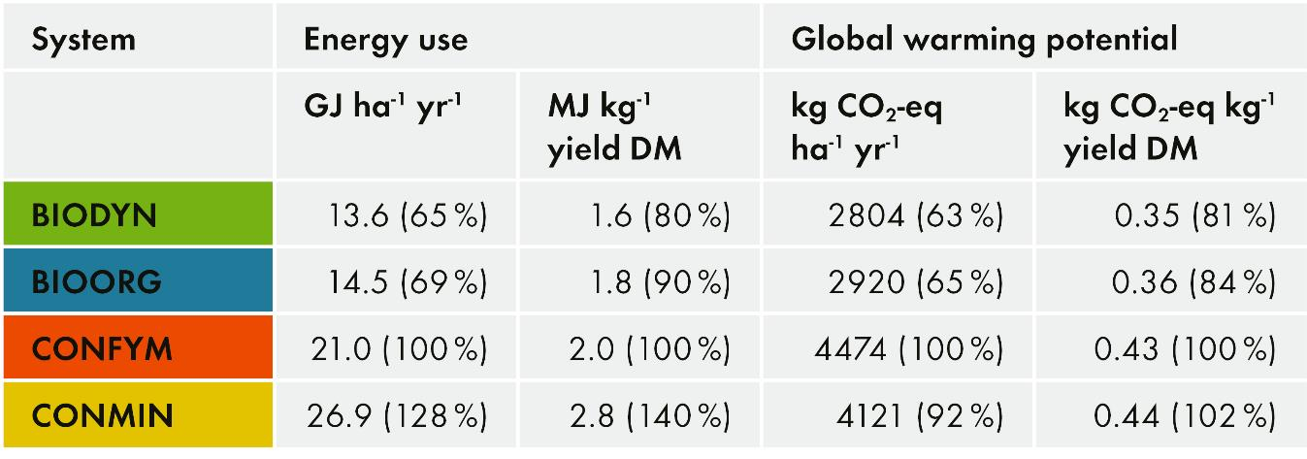
Energy consumption and global warming potential in the DOK Trial (1985-1998) from a life cycle assessment
Nemecek et al. (2011)
Energy savings: Organic farming does not use synthetic chemical fertilisers and pesticides. Compared to conventional farming, energy consumption is therefore 30 per cent lower.
This advantage is reduced to 10-20 % per yield unit.

Slide 34
Thanks to
Financing
Federal Office for Agriculture FOAG
Federal Office for the Environment FOEN
Swiss National Science Foundation
Coop Fund for Sustainability
European Commission
Lease of study areas Therwil
Agrico Cooperative, Birsmattehof, Therwil
Stamm family, Oberwil
Partner institutions
Field teams
Consulting farmers

Slide 35
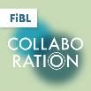
FiBL online
www.fibl.org
www.bioaktuell.ch
fiblfilm
Podcast «FiBL Collaboration»
@FiBLaktuell
linkedin.com/company/fibl
@fiblorg

Slide 36
Contact
Research Institute of Organic Agriculture FiBL Ackerstrasse 113, Box 219 5070 Frick Switzerland
Phone +41 (0)62 865 72 72
info.suisse@fibl.org www.fibl.org

